Slide 1
Category review: Chips
June 2020
Retail Analytics
Presented By
SAM KUMAR.R
Brand note: If client logo is not required, use alternate title page layout right click slide thumbnail > Layout > Title

Slide 2
Notes:
To view Privacy video explaining how important data privacy is to Quantium, please click here: https://www.youtube.com/watch?v=Zq1QDAkoRzU
or here Q:\Company Reference\Brand & Design\Brand videos\Q Privacy.mp4
At Quantium, we believe that data is the behavioural footprint of humanity and that it has to be treated with the utmost care and responsibility.
Histories, attitudes, indeed lives are stored within it in ways that aren’t always apparent – and that’s what makes its potential so powerful.
To work with it responsibly, sensitively, we set ourselves the highest data privacy protection and governance standards.
We have spent 17 years perfecting privacy-by-design and secure-by-design principles. Central to this is not holding any personally identifiable information about people –
we neither receive it, and put the necessary protections in place to be unable to decipher it.
Every aspect of handling data is safeguarded: from its de-identification, to its encryption – data security is paramount and of the highest grade.
We pride ourselves on gaining the trust of iconic organisations around the world through years of securely working with their data,
and in turn the trust that builds with their stakeholders.

Slide 3
Executive summary
Insights We can see that the increase in sales occurs in the lead-up to Christmas and that there are zero sales on Christmas day itself. This is due to shops being closed on Christmas day.
Young Singles/Couples (Mainstream) Pay the Most: They have the highest average unit price (4.07), indicating a preference for higher-priced products.
Kettle is the Most Associated Brand
Many chips brands (Thins, Smiths, RRD, Pringles, Doritos) frequently lead to Kettle purchases (37.7% confidence for Thins → Kettle).
Strong Association with Item 175
(170, 150) → 175 (56.1% confidence, 1.22 lift) suggests buying 170 & 150 together increases the likelihood of purchasing 175.
Single items 150, 134, 110, and 165 also strongly associate with 175 (≥ 42% confidence).
01
Task 1
Insights
The results show that the trial in store 77 and 86 is significantly different to its control store in the trial period as the trial store performance lies outside the 5% to 95% confidence interval of the control store in two of the three trial months and also control store and the trail store have a same trend line and the control store have a good inverse in the sale and also align with the trial store trend line but when coming to store (88) we can notice same trend line but the sales of trial store is greater than the actual control store so we need to focus more on the store 88 and the associated store 178 .
The results for trial stores 77 and 88 during the trial period show a significant difference in at least two of the three trial months but this is not the case for trial store 86. We can check with the client if the implementation of the trial was different in trial store 86 but overall, the trial shows a significant increase in Number of unique customers. 📈⬆️
02
Task 2

Slide 4
01
Category

Slide 5
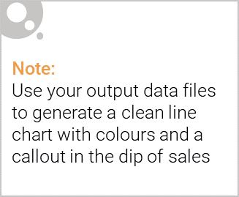
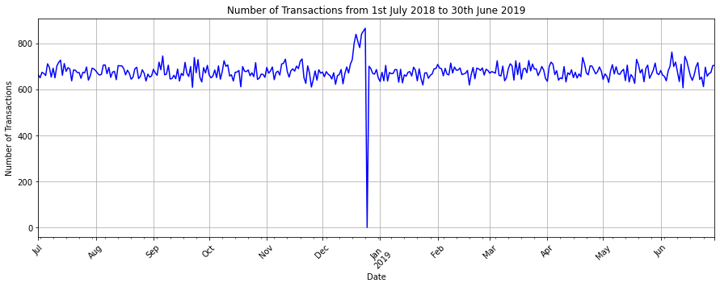
We can see that the increase in sales occurs in the lead-up to Christmas and that there are zero sales on Christmas day itself. This is due to shops being closed on Christmas day.

Slide 6

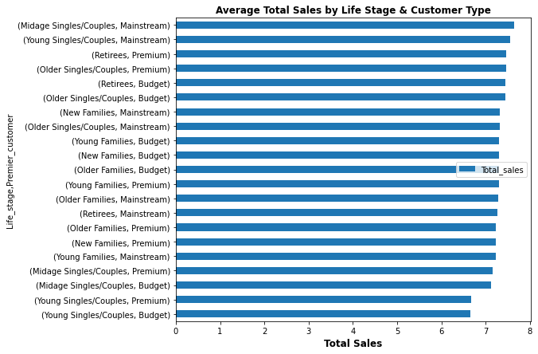
This shows the Top Performers: Midge Singles/Couples (Mainstream) have the highest total sales per customer (7.64), followed closely by Young Singles/Couples (Mainstream) and Retirees (Premium).
Premium vs. Budget: Premium customers do not significantly outperform Budget/Mainstream customers, suggesting pricing strategy and customer preferences drive similar spending patterns across segments.

Slide 7
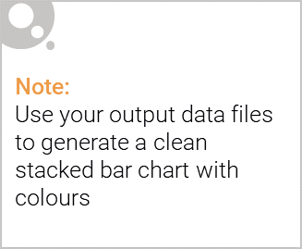
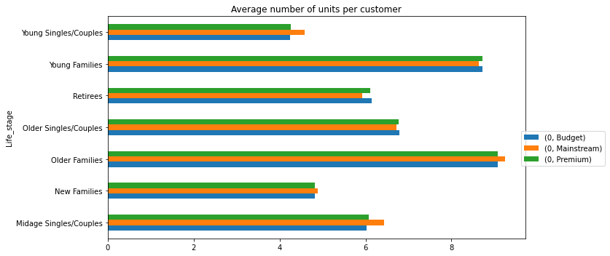
Editable (delete this)
Older Families Spend the Most: Older Families across all customer segments (Mainstream, Budget, Premium) have the highest values, indicating they are the most valuable group.
Young Families Rank Second: Their spending is slightly lower than Older Families but still higher than other life stages
.
Young Singles/Couples Spend the Least: Their values are the lowest, suggesting lower purchasing power or engagement compared to older demographics.

Slide 8
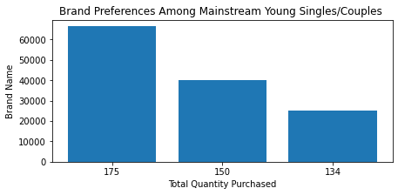
Editable (delete this)
175g packs are the most frequently purchased, indicating a strong customer preference for larger pack sizes.
150g packs follow, showing a notable demand but lower than the top-selling size.
This pattern suggests that customers may prioritize value-for-money or bulk purchases, influencing product stocking and promotional strategies.

Slide 9
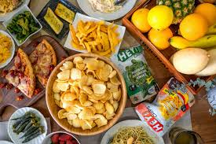
Editable (delete this)
Insights from the Apirori Algorithm (Chip sales)
Key Insights (Confidence ≥ 30%)
Kettle is the Most Associated Brand
Many chips brands (Thins, Smiths, RRD, Pringles, Doritos) frequently lead to Kettle purchases (37.7% confidence for Thins → Kettle).
Strong RRD-Smiths Connection
RRD → Smiths (35.4% confidence, 1.75 lift) suggests RRD buyers are highly likely to buy Smiths, making it ideal for bundled promotions.
Marketing Strategy
Promote Kettle with Thins, Smiths, or Pringles for better cross-sales.
Pair RRD & Smiths in offers to boost sales. 🚀selling strategies!

Slide 10
Editable (delete this)
Insights from the Apirori Algorithm (Chip Weights )
Key Insights (Confidence ≥ 30%)
Strong Association with Item 175
(170, 150) → 175 (56.1% confidence, 1.22 lift) suggests buying 170 & 150 together increases the likelihood of purchasing 175.
Single items 150, 134, 110, and 165 also strongly associate with 175 (≥ 42% confidence).
Item 150 & 175 Have Mutual Influence
175 → 150 (30% confidence, 0.96 lift) and 150 → 175 (43.9% confidence, 0.96 lift) show strong bidirectional association.
Promote 150 & 175 together to maximize cross-sales.
Marketing Strategy
Bundle 170, 150 & 175 for targeted promotions.
Recommend 150 when selling 175, and vice versa to enhance sales.

Slide 11
02
Trial store performance

Slide 12
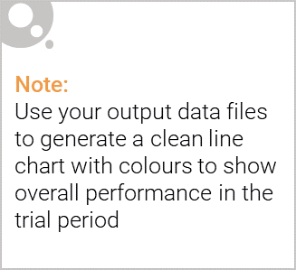
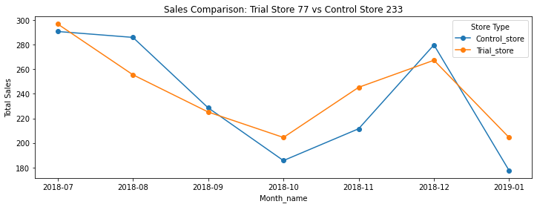
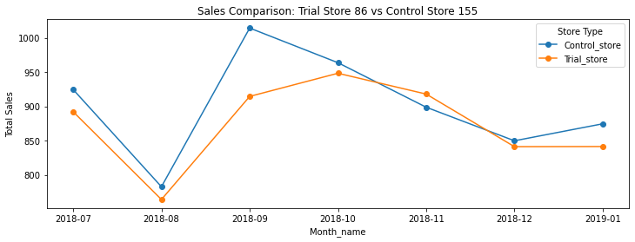
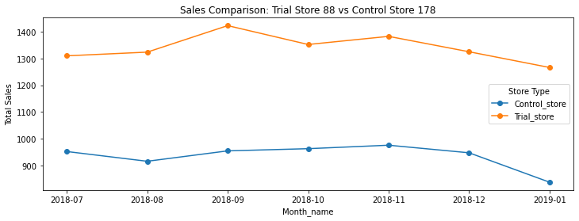
Control store vs Trial stores Total Sales
Insights
The results show that the trial in store 77 and 86 is significantly different to its control store in the trial period as the trial store performance lies outside the 5% to 95% confidence interval of the control store in two of the three trial months and also control store and the trail store have a same trend line and the control store have a good inverse in the sale and also align with the trial store trend line but when coming to store (88) we can notice same trend line but the sales of trial store is greater than the actual control store so we need to focus more on the store 88 and the associated store 178 .

Slide 13
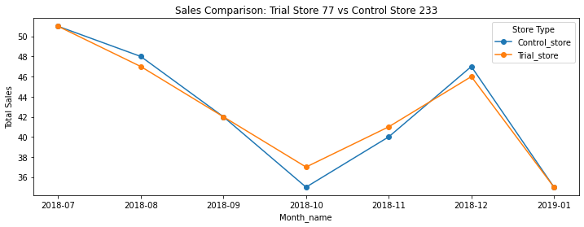
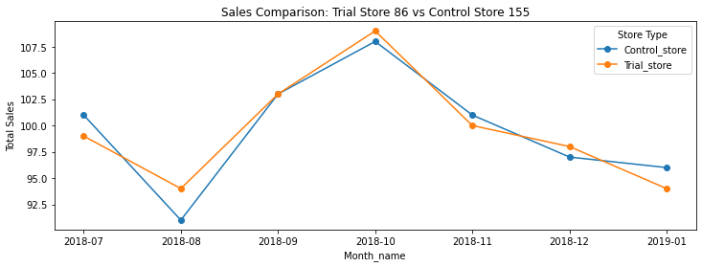
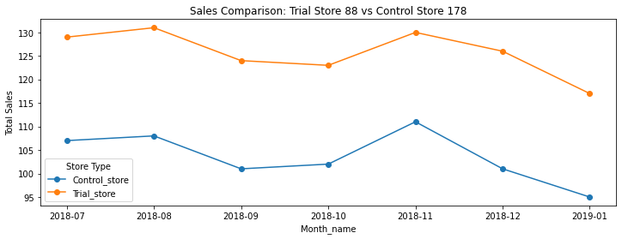
Control store vs Trial stores Unique customers
Insights
The results show that the trial in store 77 and 86 is significantly different to its control store in the trial period as the trial store performance lies outside the 5% to 95% confidence interval of the control store in two of the three trial months and also control store and the trail store have a same trend line and the control store have a good inverse in the number of customer and also align with the trial store trend line but when coming to store (88) we can notice same trend line but the number of unique customer of trial store is greater than the actual control store so we need to focus more on the store 88 and the associated store 178 .

Slide 14
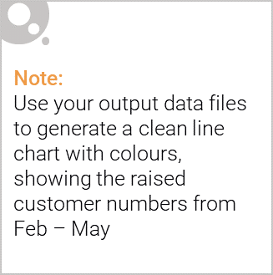
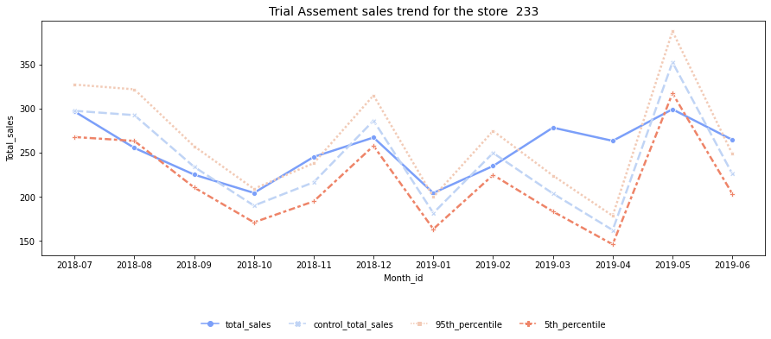
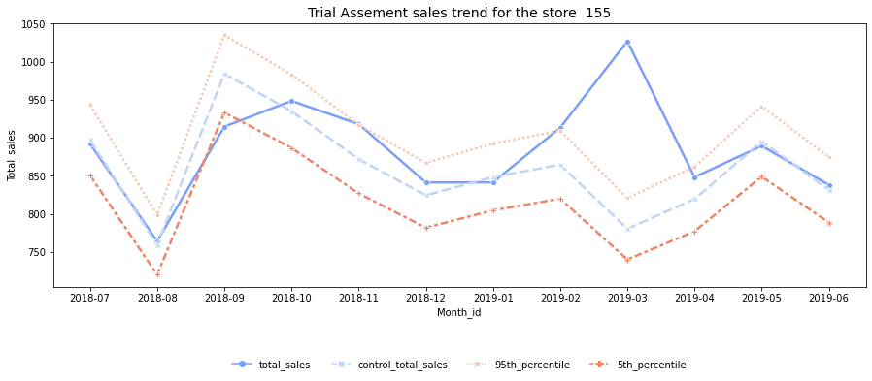
Total Sales
Increase in the total sales
Increase in the total sales

Slide 15
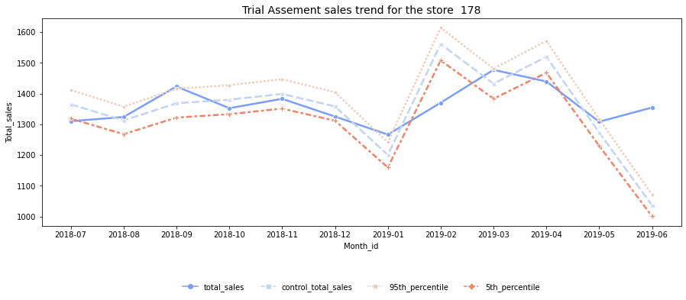
Total Sales
Dip in the Total Sales
Insights
The results for trial stores 77 and 88 during the trial period show a significant difference in at least two of the three trial months but this is not the case for trial store 86. We can check with the client if the implementation of the trial was different in trial store 86 but overall, the trial shows a significant increase in Total sales

Slide 16
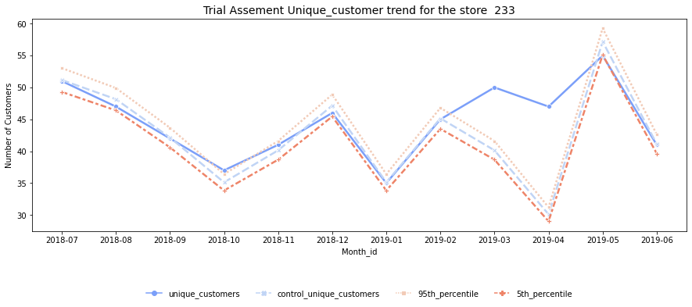
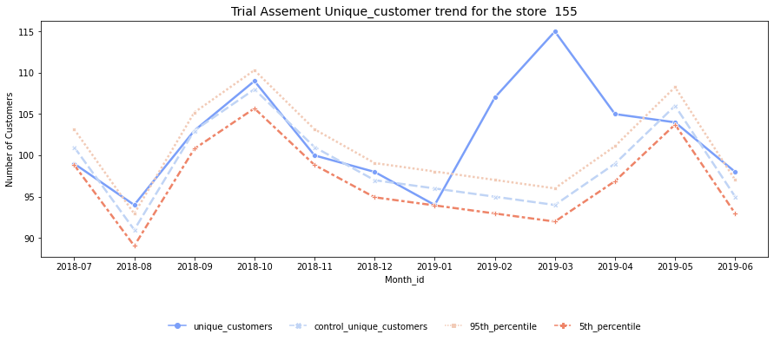
Unique Customer
Increase in the customer
Increase in the customer

Slide 17
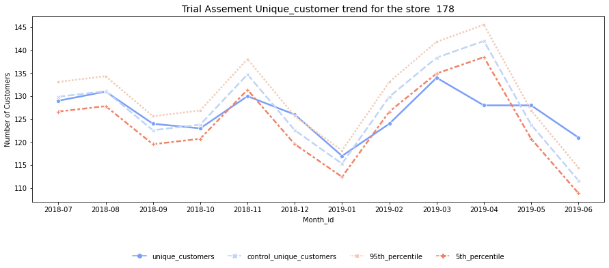
Unique Customers
Dip in the Customer
Insights
The results for trial stores 77 and 88 during the trial period show a significant difference in at least two of the three trial months but this is not the case for trial store 86. We can check with the client if the implementation of the trial was different in trial store 86 but overall, the trial shows a significant increase in Number of unique customers. 📈⬆️⬇️

